Slide 1

MY SQL
PROJECT ON
CRICKET
BY
ARYAN CHAURASIA

Slide 2

SQL PROJECT ON CRICKET
Demonstrates practical database design and querying using a real-world dataset of 30 world-renowned cricketers. Built entirely in MySQL under the database cricket_db, the project consists of five interconnected tables — players, teams, leagues, countries, and player awards — capturing details such as runs, wickets, age, nationality, role, market value, and team/league.
INTRODUCTION
FIVE TABLES
• players
• teams
30
15
6
14
• leagues
Players
Teams
Leagues
Awards
• countries
• player_awards

Slide 3
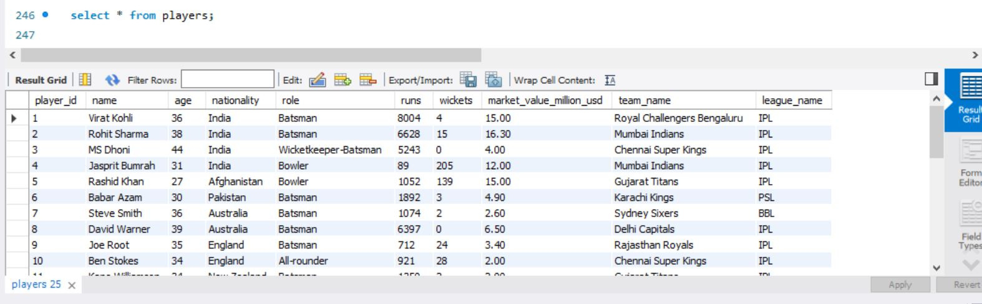
TABLE 1 — PLAYERS
DATABASE: CRICKET_DB

Slide 4
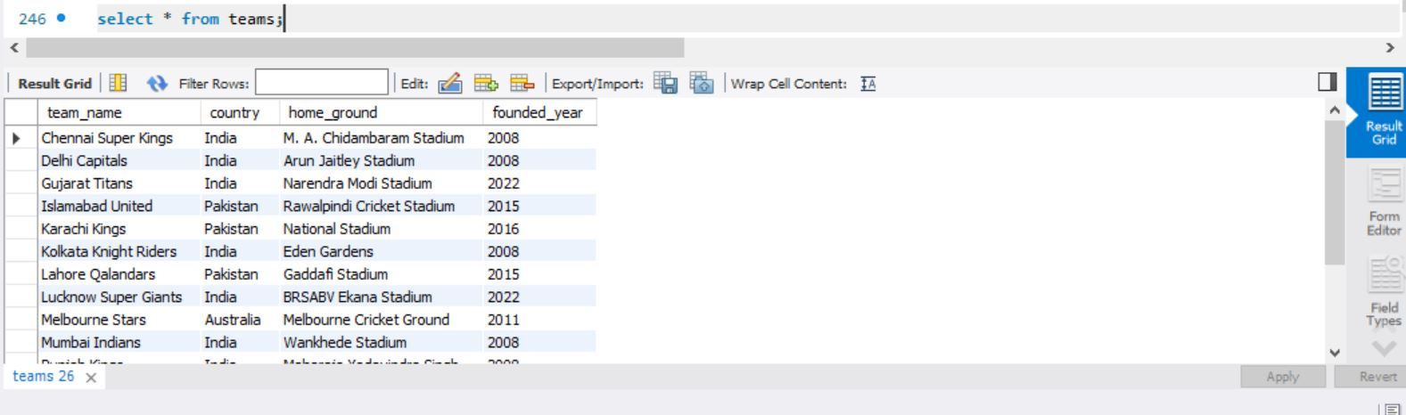
TABLE 2 — TEAMS

Slide 5
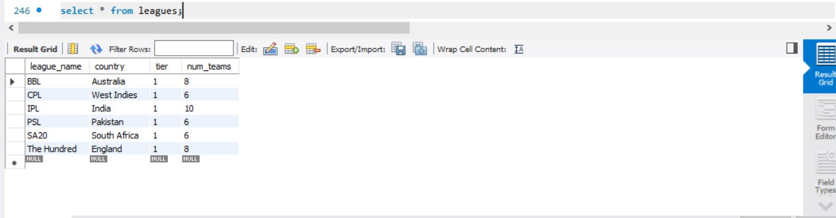
TABLE 3 — LEAGUES

Slide 6
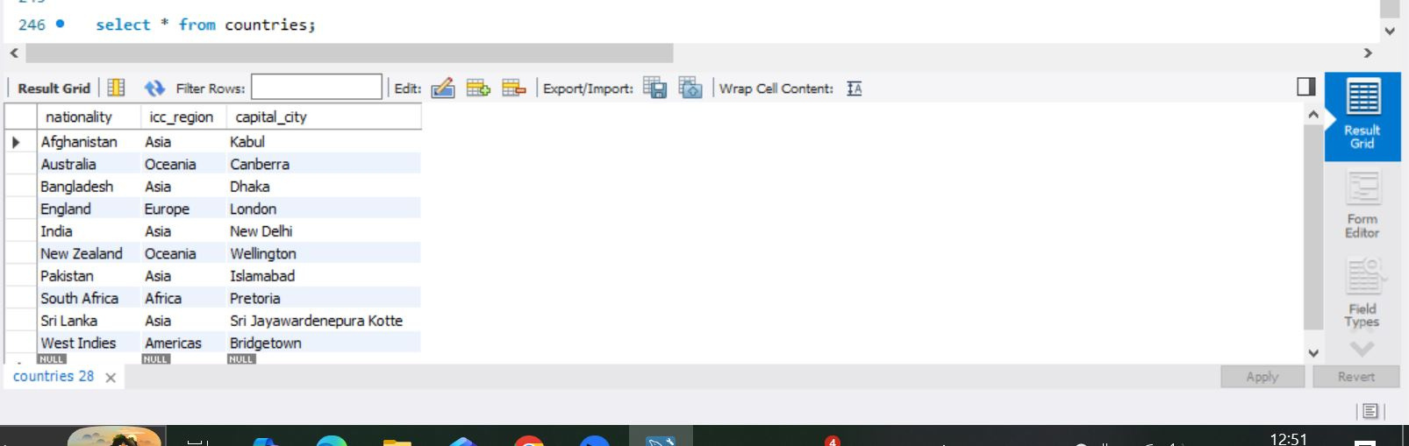
TABLE 4 — COUNTRIES

Slide 7
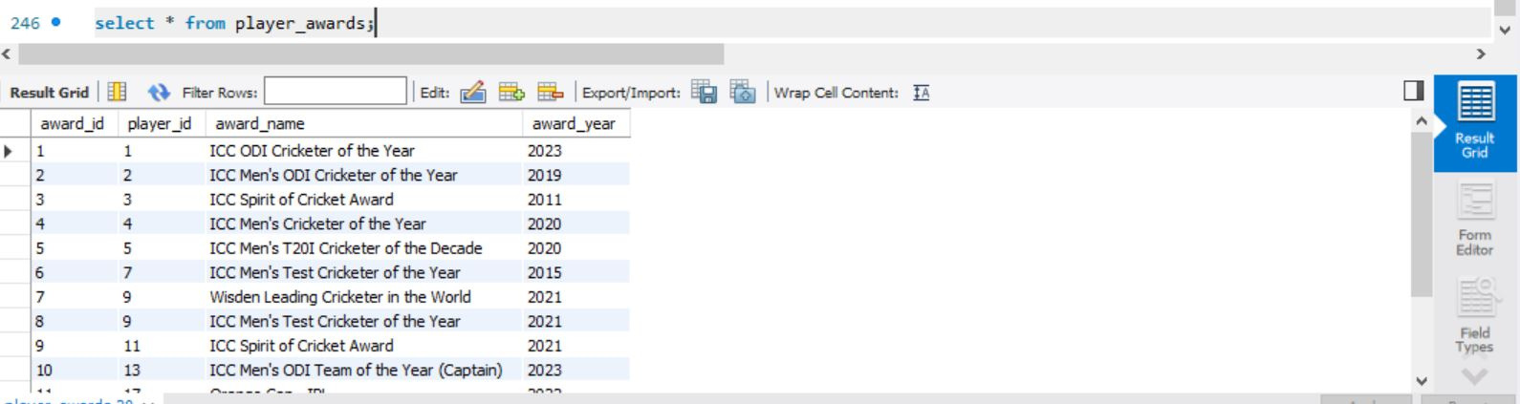
TABLE 5 — PLAYER AWARDS

Slide 8
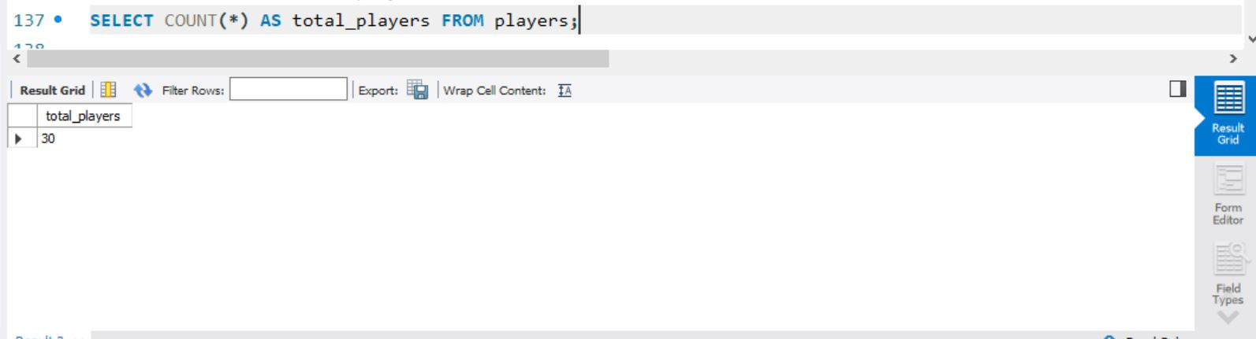
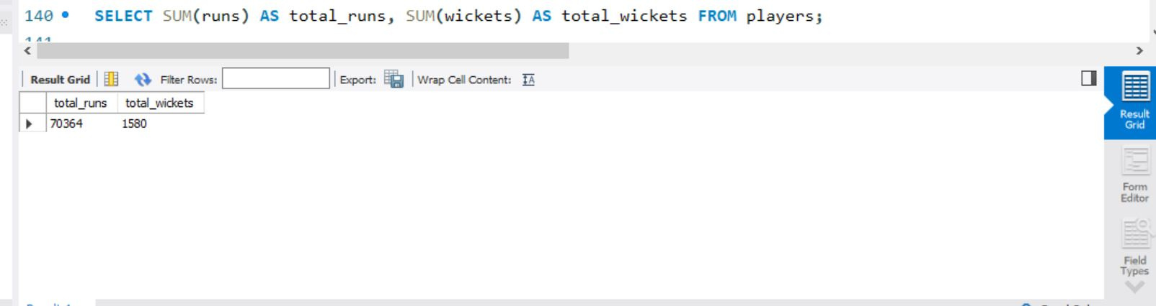
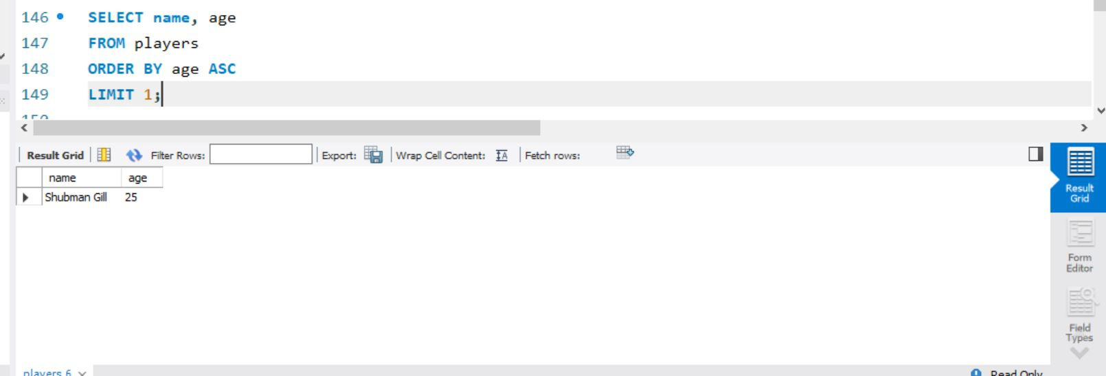
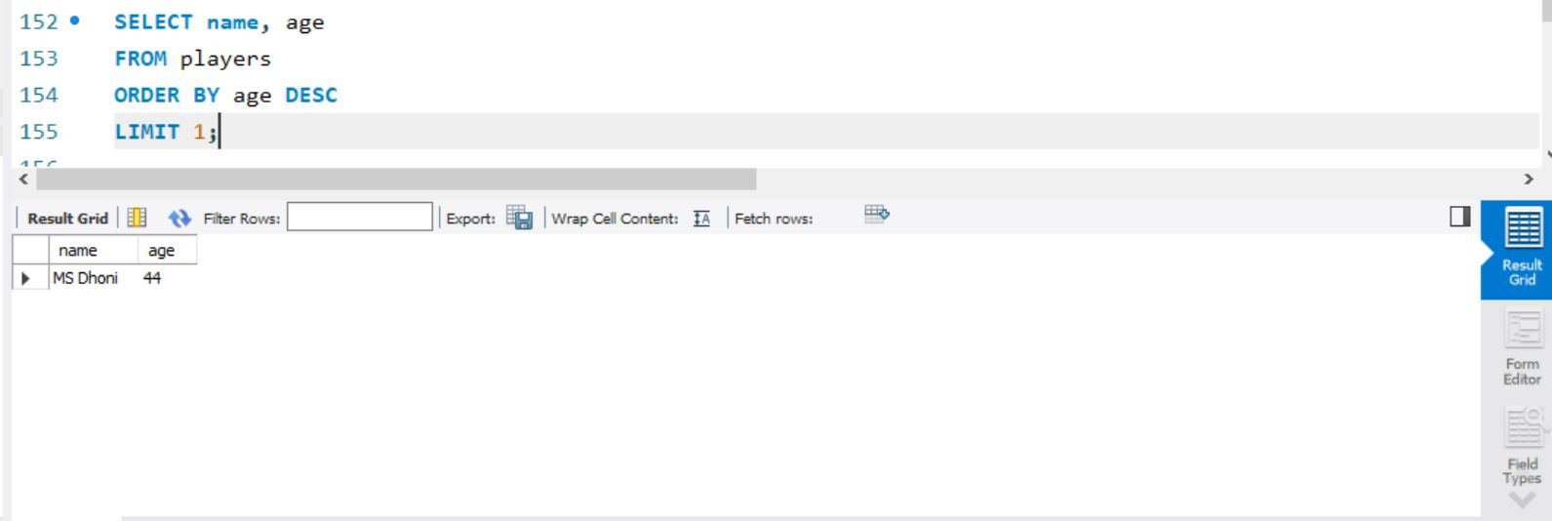
TOTAL NUMBER OF
PLAYERS
TOTAL RUNS &
WICKETS
YOUNGEST PLAYER
OLDEST PLAYER

Slide 9
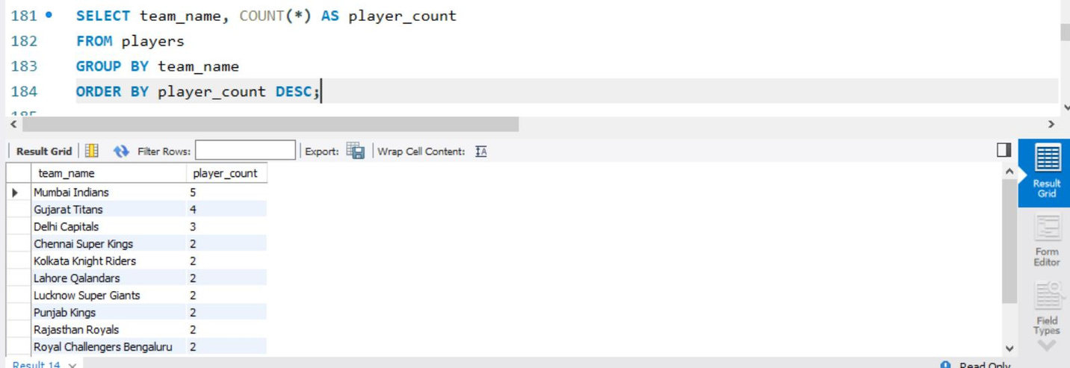
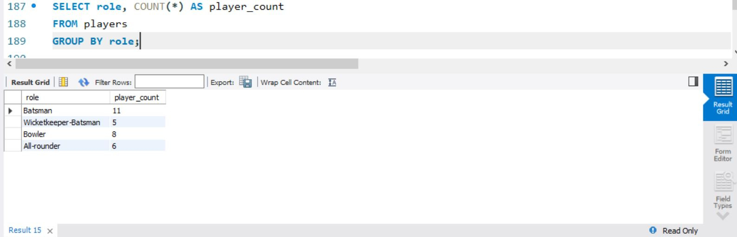
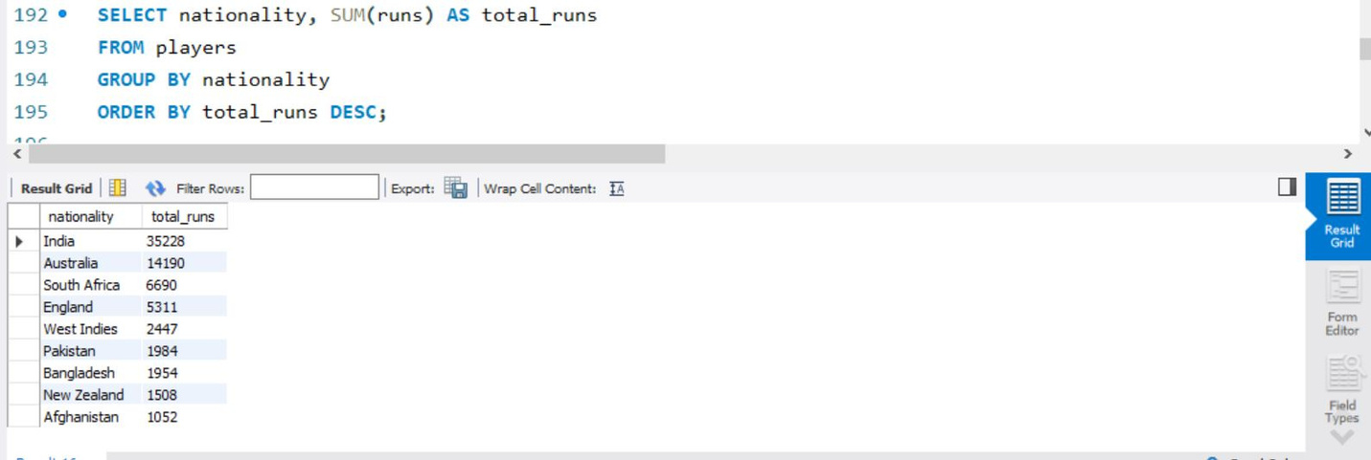
NUMBER OF PLAYERS
IN EACH TEAM
PLAYERS BY ROLE
RUNS SCORED BY
NATIONALITY

Slide 10
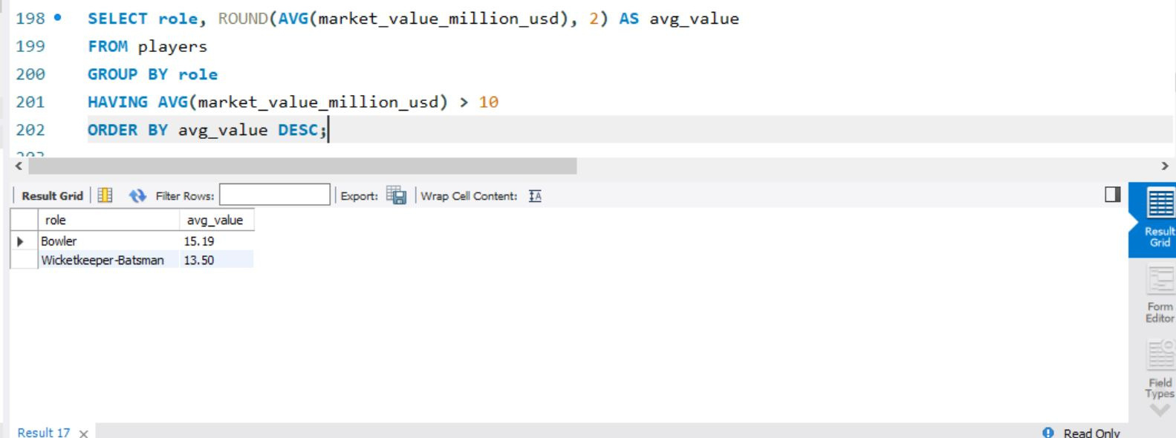
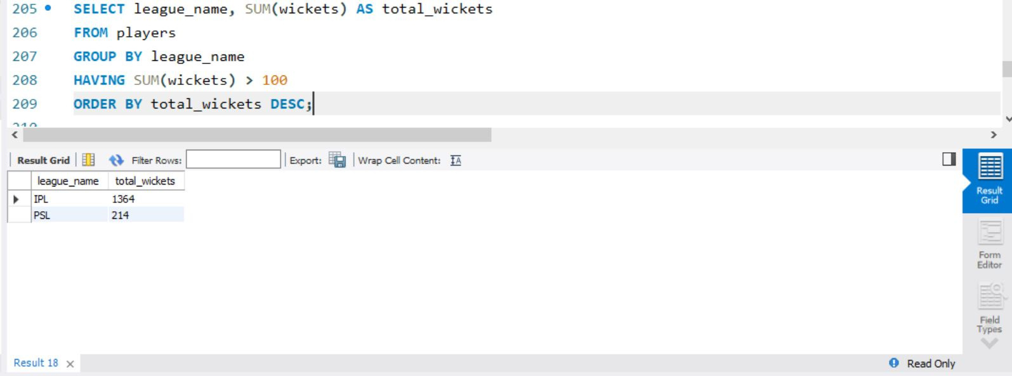
AVERAGE MARKET VALUE BY
ROLE — ONLY ROLES
ABOVE $10M
TOTAL WICKETS BY
LEAGUE — ONLY LEAGUES
ABOVE 100

Slide 11
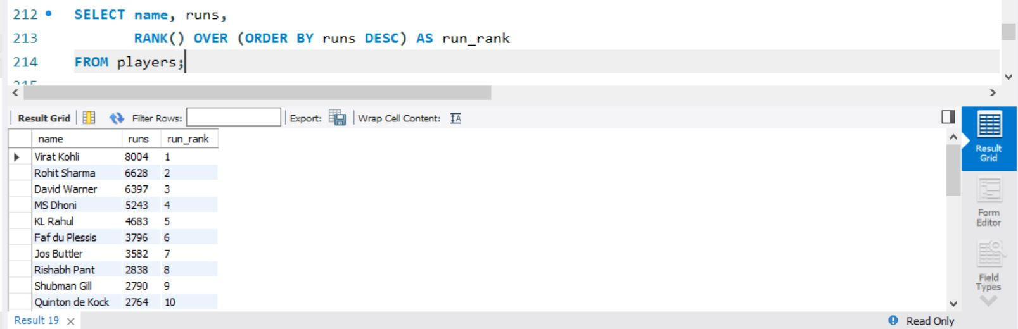
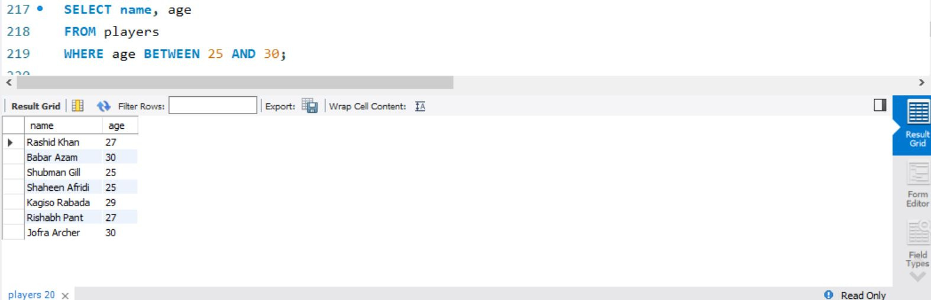
TOP 10 PLAYERS
BY RUNS
PLAYERS AGED 25–30

Slide 12
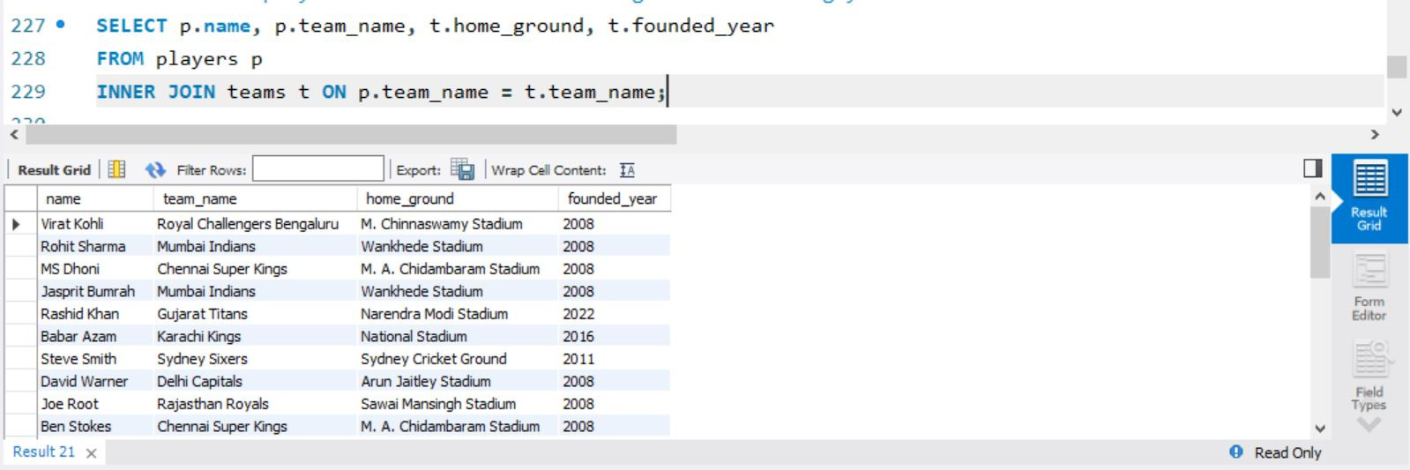
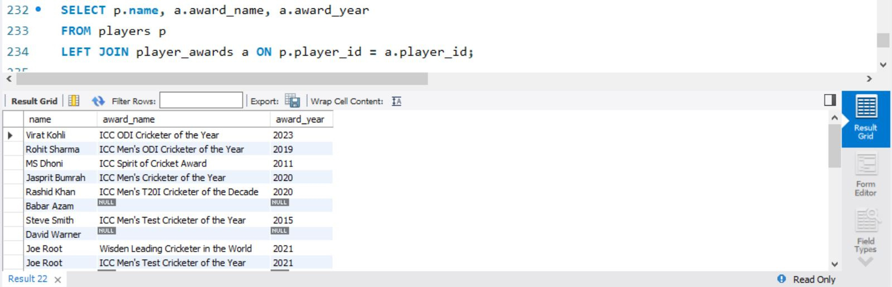
PLAYERS WITH THEIR
TEAM'S GROUND
PLAYERS WITH ANY
AWARDS WON

Slide 13
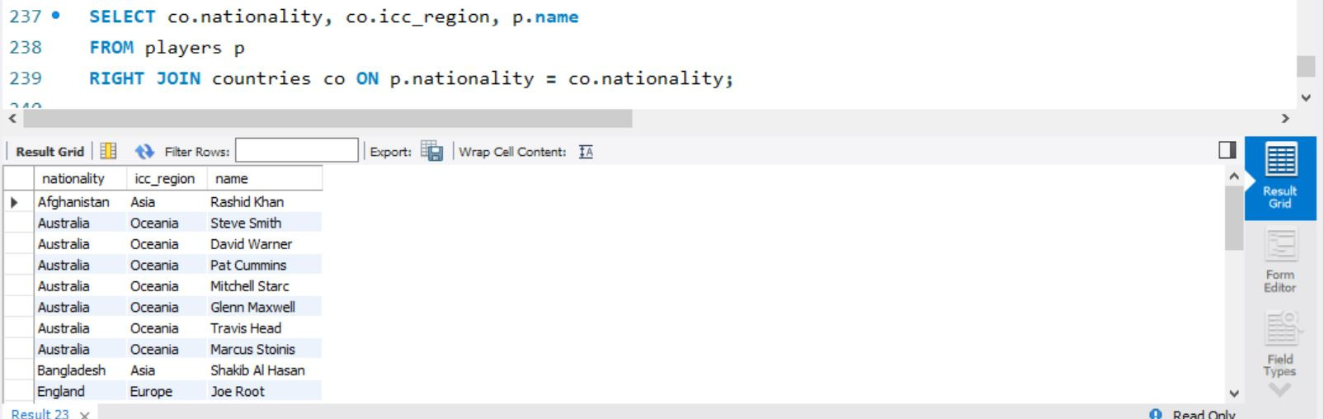
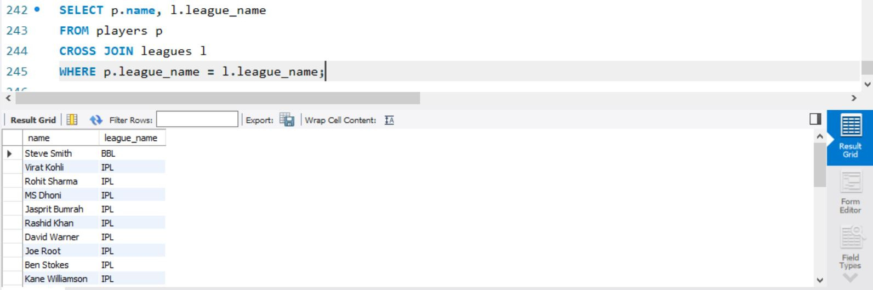
EVERY COUNTRY AND
ITS PLAYERS
PLAYERS MATCHED TO
THEIR LEAGUE

Slide 14
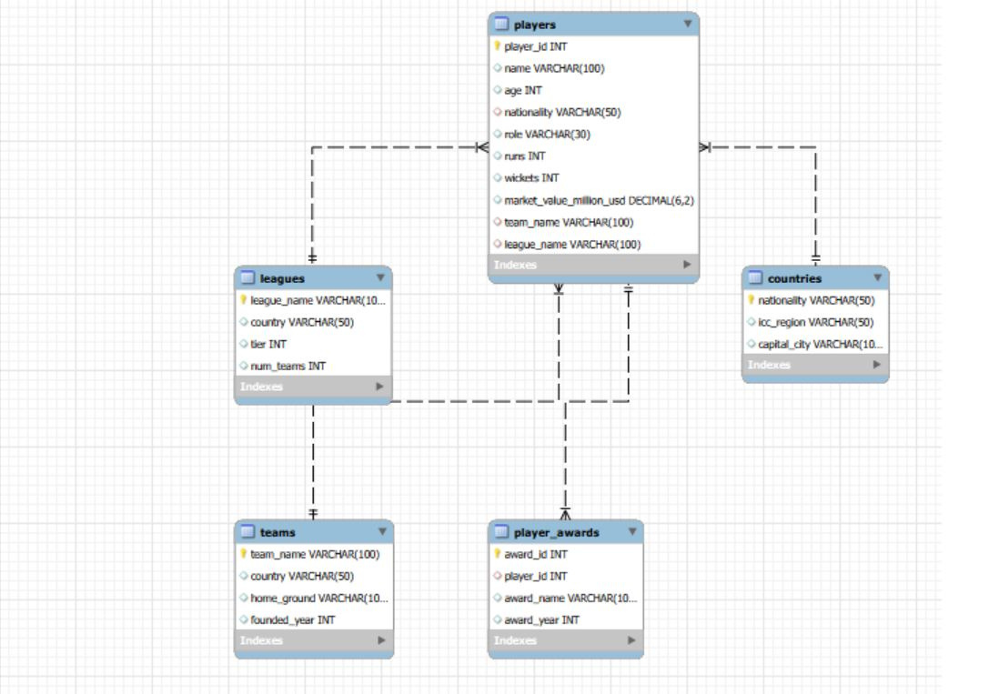
ENTITY RELATIONSHIP DIAGRAM

Slide 15
CONCLUSION
This project demonstrates how a relational database can be designed and queried to extract meaningful insights from real-world cricket data. By structuring information across five connected tables — players, teams, leagues, countries, and player awards — we were able to explore player performance, market value, team history, and national representation through a variety of SQL techniques, including aggregate functions, string and mathematical functions, GROUP BY / HAVING, window ranking, and all four major join types.
SQL TECHNIQUES USED
• Aggregate Functions
• GROUP BY / HAVING
• Window Ranking
• Inner / Left / Right / Cross Joins

Slide 16
THANK YOU

